Slide 1
CS380
Flocking Research Project

Slide 2
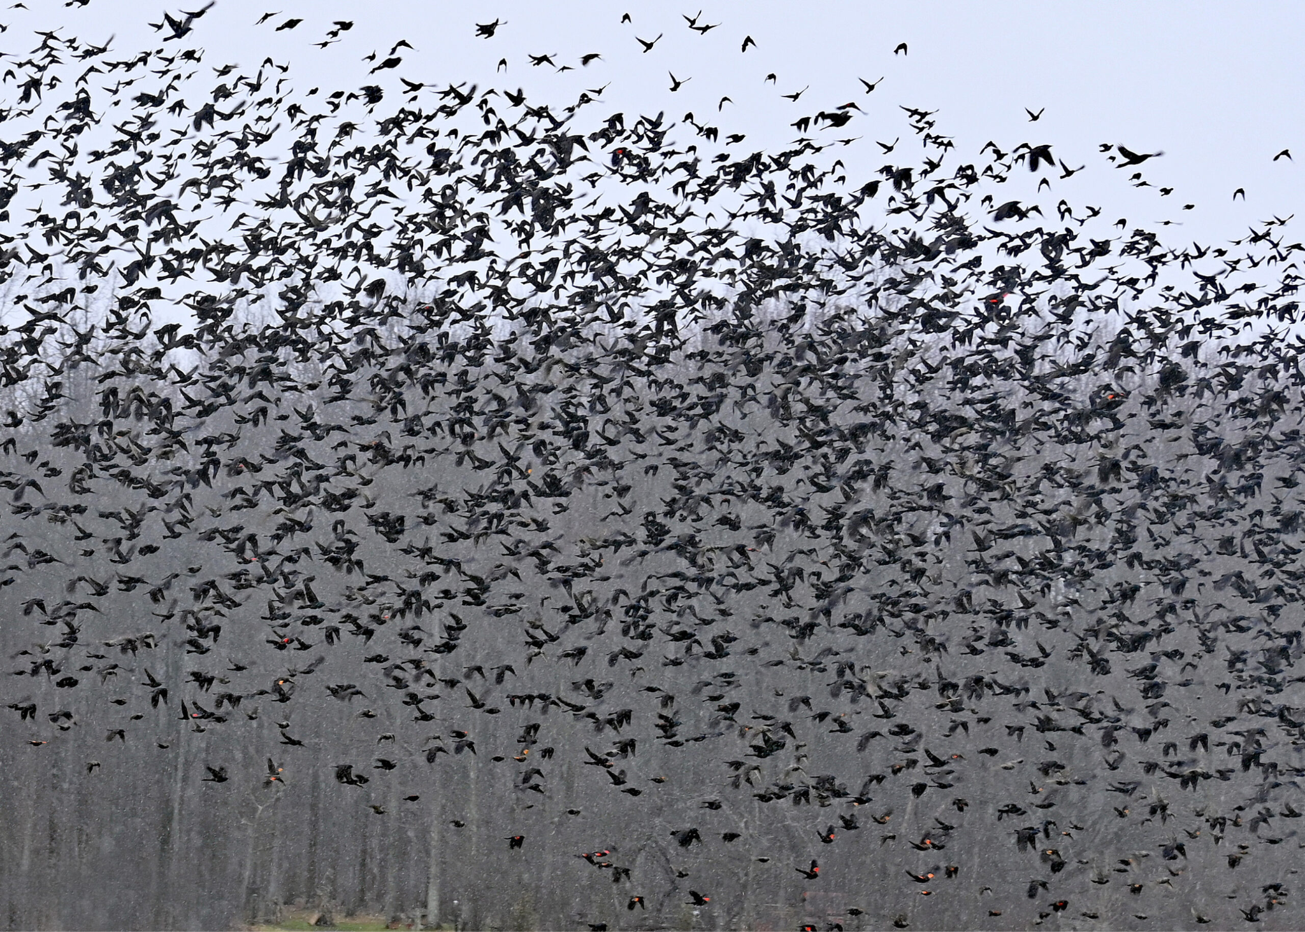

What is Flock?
Bird flock
Fish flock
Notes:
Flocking refers to the natural phenomenon where animals such as flocks of birds or schools of fish move together as a group.
In this process, each individual moves according to specific rules, creating harmonious and efficient movement.
https://www.farmanddairy.com/top-stories/birds-of-a-feather-flocking/849257.html
https://www.shutterstock.com/ko/search/fish-flock

Slide 3

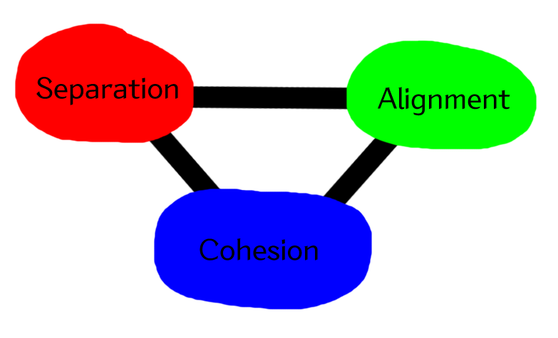
Boids(Bird-Oid Object) Algorithm
Craig W. Reynolds
Notes:
In 1986, Craig Reynolds developed the Boids algorithm.
This is a swarm simulation technique that focuses on mimicking the flocking behavior just described. Because this algorithm can naturally emulate the behavior of animals moving in groups, it is frequently used in areas such as game AI. In particular, in game development, it can be used to implement the natural movements of NPCs, making it a very important algorithm in AI technology.
https://www.red3d.com/cwr/

Slide 4
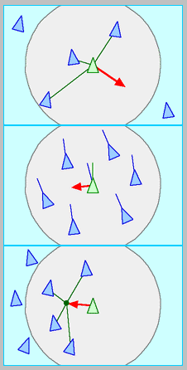
Boids(Bird-Oid Object) Algorithm
Separation: steer to avoid crowding local flockmates
Alignment: steer towards the average heading of local flockmates
Cohesion: steer to move toward the average position of local flockmates
Notes:
The Boids algorithm follows three basic rules: Separation, Alignment, and Cohesion.
The Boids algorithm follows three basic rules: Separation, Alignment, Cohesion.
Separation: This rule involves each individual trying to maintain a distance from nearby individuals. It prevents collisions and ensures that individuals do not become excessively crowded.
Alignment: This rule requires each individual to match the average direction of movement of its neighboring individuals. It helps maintain a consistent direction for the entire group.
Cohesion: This rule causes each individual to move towards the center of the surrounding individuals. It prevents individuals from dispersing and makes the group appear as a single cohesive unit. Based on these three rules, various swarm simulations can be created through parameter adjustments.
https://www.red3d.com/cwr/

Slide 5
Common stuffs
Speed : 10.0
Neighbor Radius : 5.0
Separation Radius : 2.0
Separation Weight : 2.0
Alignment Weight : 1.0
Cohesion Weight : 1.5
[Linear] Separation Mode & [Center] Cohesion Mode
Notes:
[Disabled Slide]

Slide 6
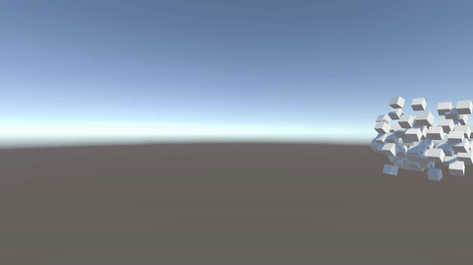
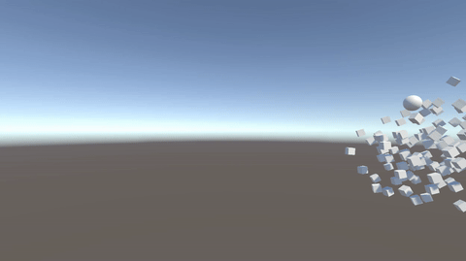
Speed
speed 5
speed 15
Notes:
We decided to implement the Boid algorithm in Unity and apply different algorithms to the separation and cohesion processes to compare and analyze the differences.
For a clear comparison, we set the direction of each object in the demo to be a circular sphere and added six modifiable parameters to make it easier to observe the changes in the clusters.
First, Speed. This variable changes the speed at which each individual moves. We found that increasing the speed causes each individual to move faster, potentially reducing cohesion, while decreasing the speed too much can make the group appear too clumped.

Slide 7
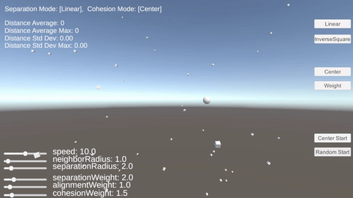
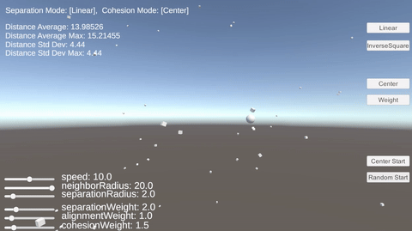
Neighbor Radius
neighbor radius 1
neighbor radius 20
Notes:
Second, Neighbor Radius. This value represents the range within which each individual recognizes surrounding individuals. When this value increases, we observed that individuals interact with more members, resulting in more consistent group behavior.

Slide 8
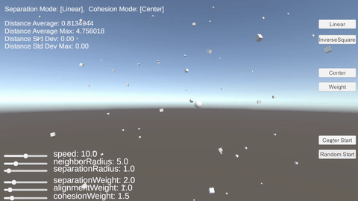
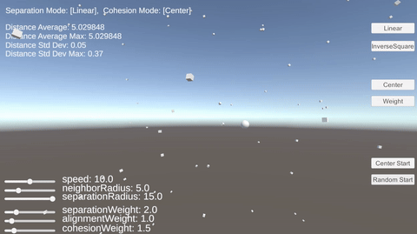
Separation Radius
separation radius 1
separation radius 15
Notes:
Third, Separation Radius. This value represents the minimum distance between individuals. We observed that increasing this value causes individuals to try to keep farther apart from each other.
image//

Slide 9


Separation Weight
separation weight 1
separation weight 10
Notes:
Fourthm Separation Weight. This value indicates the extent to which individuals push each other away. We found that increasing this value causes individuals to push each other away more, increasing the distance between them.
one another//

Slide 10
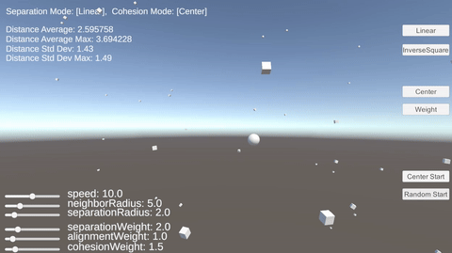

Alignment Weight
alignment weight 1
alignment weight 10
Notes:
Fifth, Alignment Weight. This value represents how much the individuals' directions should align. We observed that as this value increases, individuals attempt to move in the same direction as their surrounding members as much as possible.
ge///

Slide 11
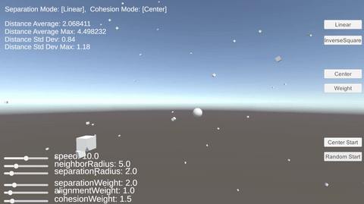
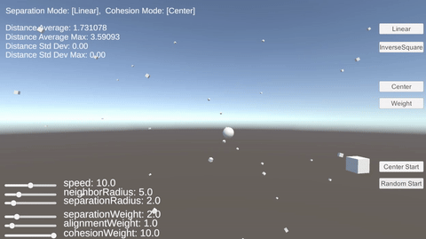
Cohesion Weight
cohesion weight 1.5
cohesion weight 10
Notes:
Sixth, Cohesion Weight. This value represents the force that pulls individuals towards the center of the group. We found that increasing this value strengthens the force that pulls individuals towards the center of the group.

Slide 12
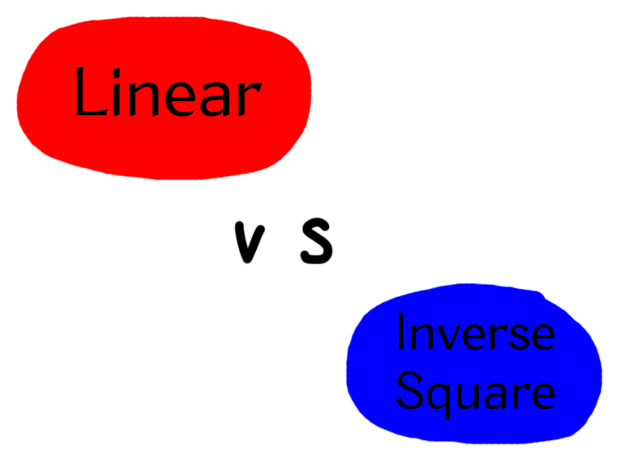
Separation Mode (Linear, Inverse Square)
Notes:
The separation algorithm is an important mechanism for avoiding collisions between voids and maintaining a proper distance between them.
In this demo, we've included two different calculation methods to compare the results between them.
The two methods we used in this demo are the Linear method and the Inverse Square method.

Slide 13
Separation Mode - Linear
Current Position − Neighbor Position
Separation Vec +=
Distance
Notes:
In linear mode, the separation vector between objects is inversely proportional to the distance between neighbors.
This means that closer neighbors apply a stronger separation force, but farther neighbors also have some influence.
The main feature of this method is that it provides smooth and stable movement, especially in dense situations, as there are no jerky movements, making it suitable for maintaining stable swarms.

Slide 14
Separation Mode - Inverse Square
Current Position − Neighbor Position
Separation Vec +=
Distance^2
Notes:
the Inverse Square mode has it inversely proportional to the square of the distance between neighbors.
This method applies a very strong separation force to close neighbors and largely ignores farther away neighbors.
As a result, in dense situations, objects will disperse faster and stronger, and collision avoidance will be much more effective. //
However, movement can be rather jerky in this process.

Slide 15
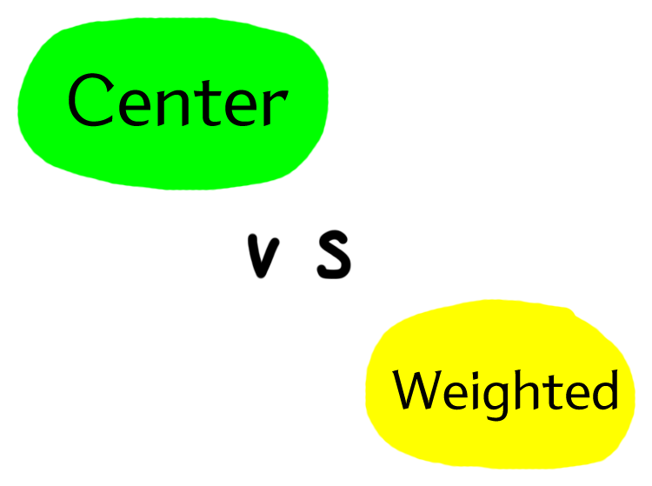
Cohesion Mode (Center, Weighted)
Notes:
Next is the cohesion algorithm,
The Cohesion algorithm determines the behavior of voids to move toward the center point with their neighbors
We'll talk about two approaches in this demo: the Center approach and the Weighted approach

Slide 16
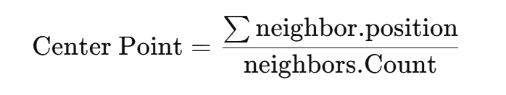
Cohesion Mode - Center
Notes:
The center mode is one of the simplest ways to compute cohesion.
This is calculated by simply adding up the positions of the neighbors and dividing by the number of neighbors.
All neighbors have the same weight, and distant neighbors are included in the calculation equally. //
This method is computationally simple and works well in uniformly distributed environments, but it has the disadvantage of potentially distorting the center point due to distant neighbors.

Slide 17
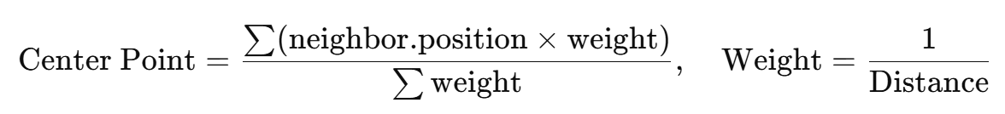
Cohesion Mode - Weighted
Notes:
The Weighted method uses distance-based weights to calculate the center point. It gives closer neighbors more influence, while farther away neighbors are relatively ignored.
This method provides more realistic aggregation behavior in dense situations. In particular, it drives natural clustering because it moves towards the nearest neighbor.
However, the downside is that it is slightly more computationally intensive. //

Slide 18

Boids Demo
Notes:
Here is the Boids demo. Here's a brief overview of the features:
First, We implemented a feature to set the Separation Mode. You can modify the Separation Mode by clicking each button.
Next, there is a feature to set the Cohesion Mode. Similarly, you can adjust the Cohesion Mode by clicking the corresponding buttons.
Below that, there is a function to create new objects. The position of the objects can be modified based on the button you click.
In the bottom-left corner, there is a feature to adjust the parameters of the objects. You can modify these parameters using sliders.
(After playing demo)
After creating the Boids algorithm, we decided to adjust the parameters to observe the differences. For a clear comparison, the direction each individual faces was set to a circular sphere in the demo, and we modified various parameters to observe changes in the swarm.

Slide 19

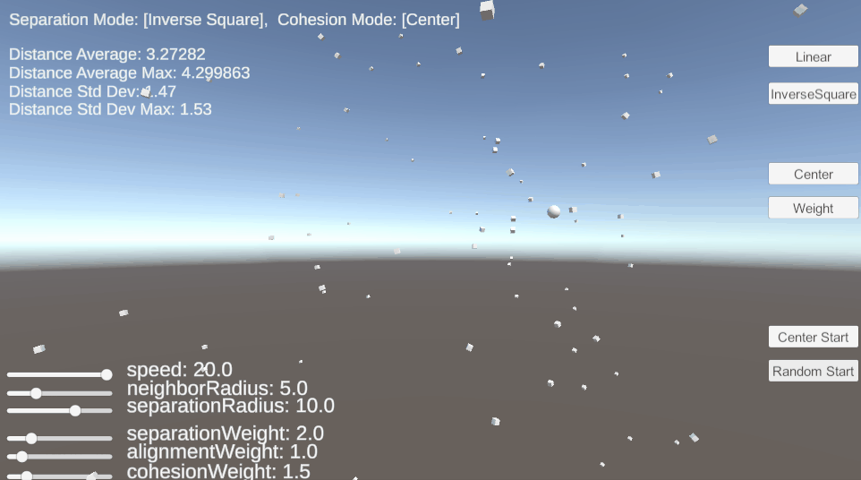
Separation : Linear & Inverse Square
Start in random position
Linear
Inverse Square
Notes:
Here is an analysis of the differences between the Separation algorithms.
We conducted an experiment to compare the two algorithms, Linear and Inverse Square. In both experiments, objects start at random points.
They looks slightly different.
The results showed that the Inverse Square method resolves conflicts faster, because it is more sensitive to close neighbors.
and the entire population aligns faster, while the Linear method is slower, because of its uniform reaction strength.

Slide 20
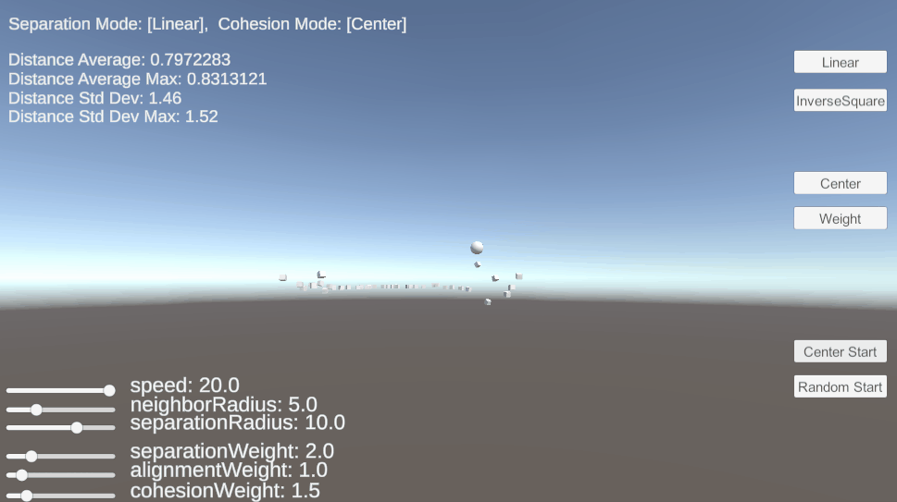
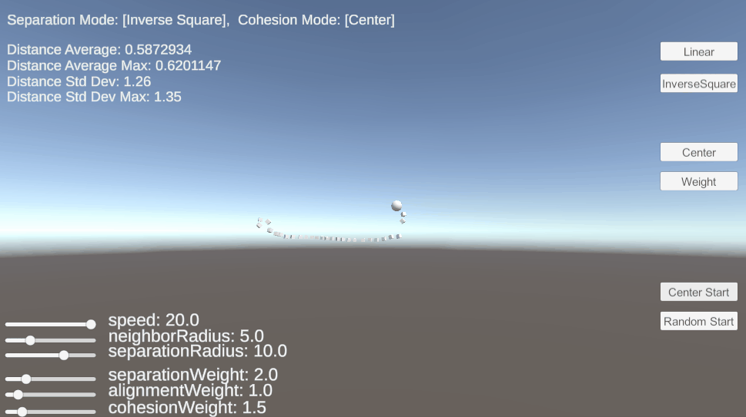
Separation : Linear & Inverse Square
Start in same certain position
Linear
Inverse Square
Notes:
Generating all objects from a single point also produced similar results.
But in the process, we were able to see that the way they spread when they were created is different - the Inverse Square method spreads faster!

Slide 21
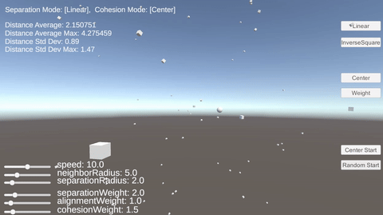
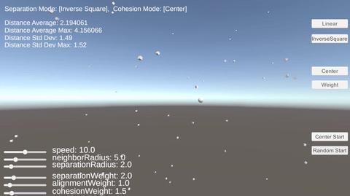
Linear vs Inverse Square
Linear (Center)
Inverse Square (Center)
Notes:
disabled slide

Slide 22

Cohesion : Center vs Weighted
Center (Linear)
Weighted (Linear)
Notes:
Next, We compared the Center Mode and Weighted Mode within the Cohesion feature.
In both experiments, all objects were randomly generated at different positions.
In Center Mode, the objects tend to individually move toward the center. in contrast, Weighted Mode appears to be more consistent in movement,
as it is influenced by nearby neighbors, increasing the likelihood of forming multiple groups.

Slide 23
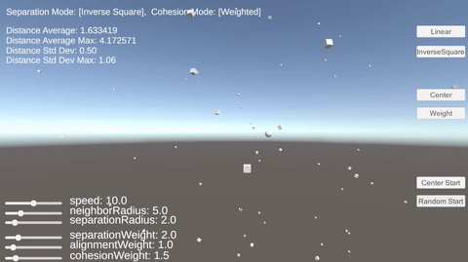
Linear, Center
Linear, Weighted
Inverse Square, Center
Inverse Square, Weighted
Notes:
The four images above are comparative images according to each mode.
The differences between them may not be easily noticeable, but there were distinctions in the clustering process and their calculation methods, as demonstrated in the comparison.

Slide 24
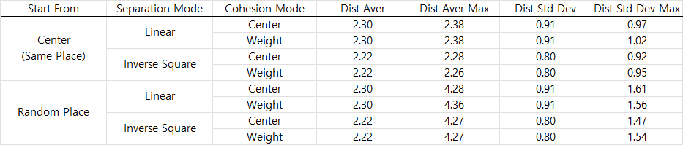
Chart
Notes:
Based on the above results, we were able to summarize the following findings:
For Linear Mode, the average distance and standard deviation of distances were found to be larger.
Weighted Mode showed a higher maximum value / for the standard deviation of distances.

Slide 25
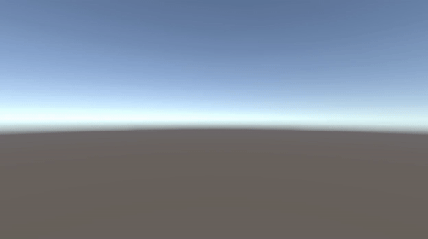
Conclusion / Findings
High Separation Weights,
High Separation Radius!!
Notes:
Through this study, we learned the roles of each component of the Boids algorithm, and which parameters need to be adjusted to achieve our desired outcomes.
For example, if we want to create Boids with VERY large bodies, well, we have to increase the Separation Weights and Separation Radius is better!

Slide 26
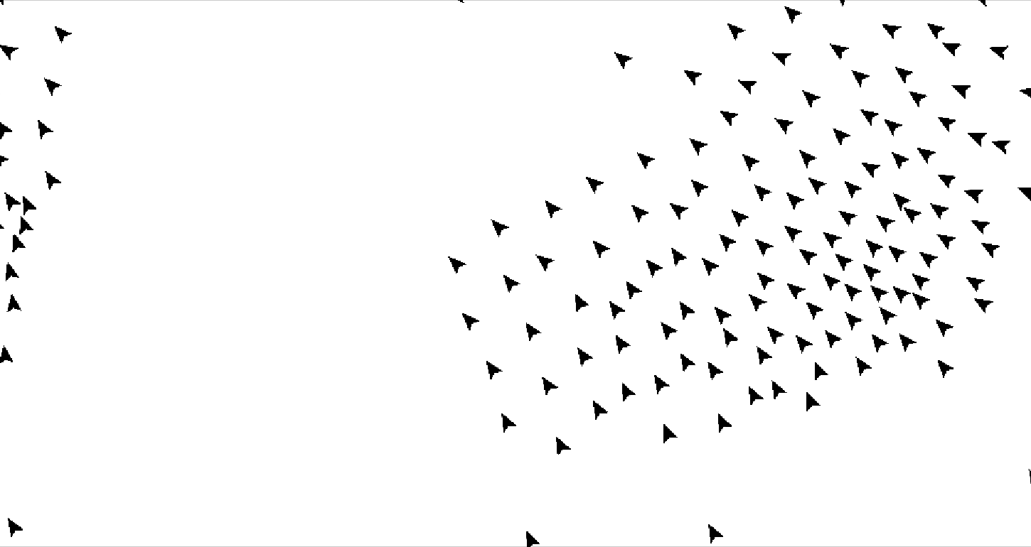
Thank you!
Notes:
Thank you for listening!
//If you have any questions, please feel free to ask!
https://people.utm.my/shahabuddin/?p=7474

